Slide 1
CSE 411: VLSI Design

Slide 2
Text Book
Books
Design of VLSI Systems: A practical Introduction
Linda E.M. Brackenburry
Other lecture materials and handouts
Scanned Copy will be provided

Slide 3
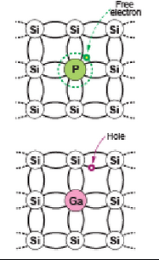
N-type and P-type Doping

Slide 4
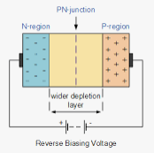
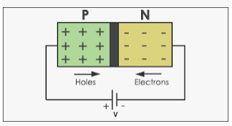
P-N Junction Diode
Forward Biasing

Slide 5
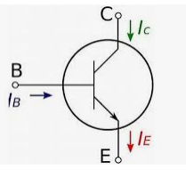
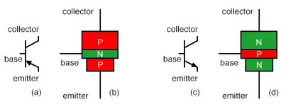
BJT
Current Driven device
NPN and PNP
Faster
More area required than MOS
More Power dissipation

Slide 6
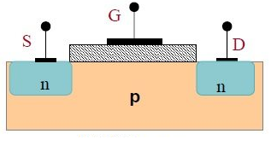
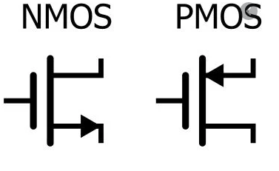
MOS
Less Area required
Less current and Power dissipation
Slower than BJT

Slide 7
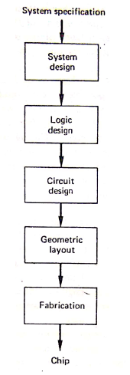
Hierarchical Design Process

Slide 8
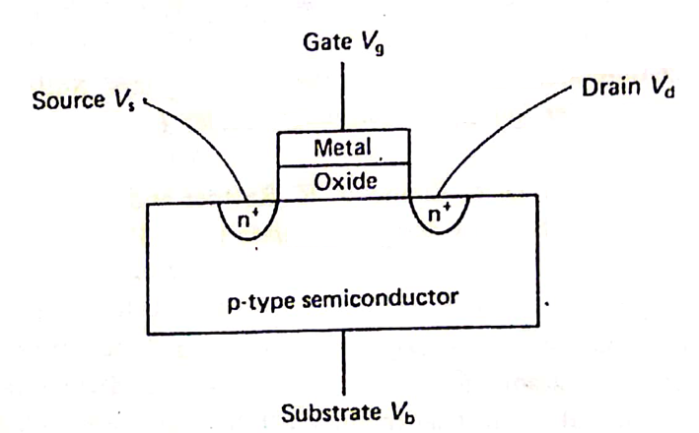
NMOS Transistor Structure

